Slide 1

Fresher Android
Saving Data – Persistent
5/6/2020
09e-BM/DT/FSOFT - ©FPT SOFTWARE – Fresher Academy - Internal Use
1

Slide 2

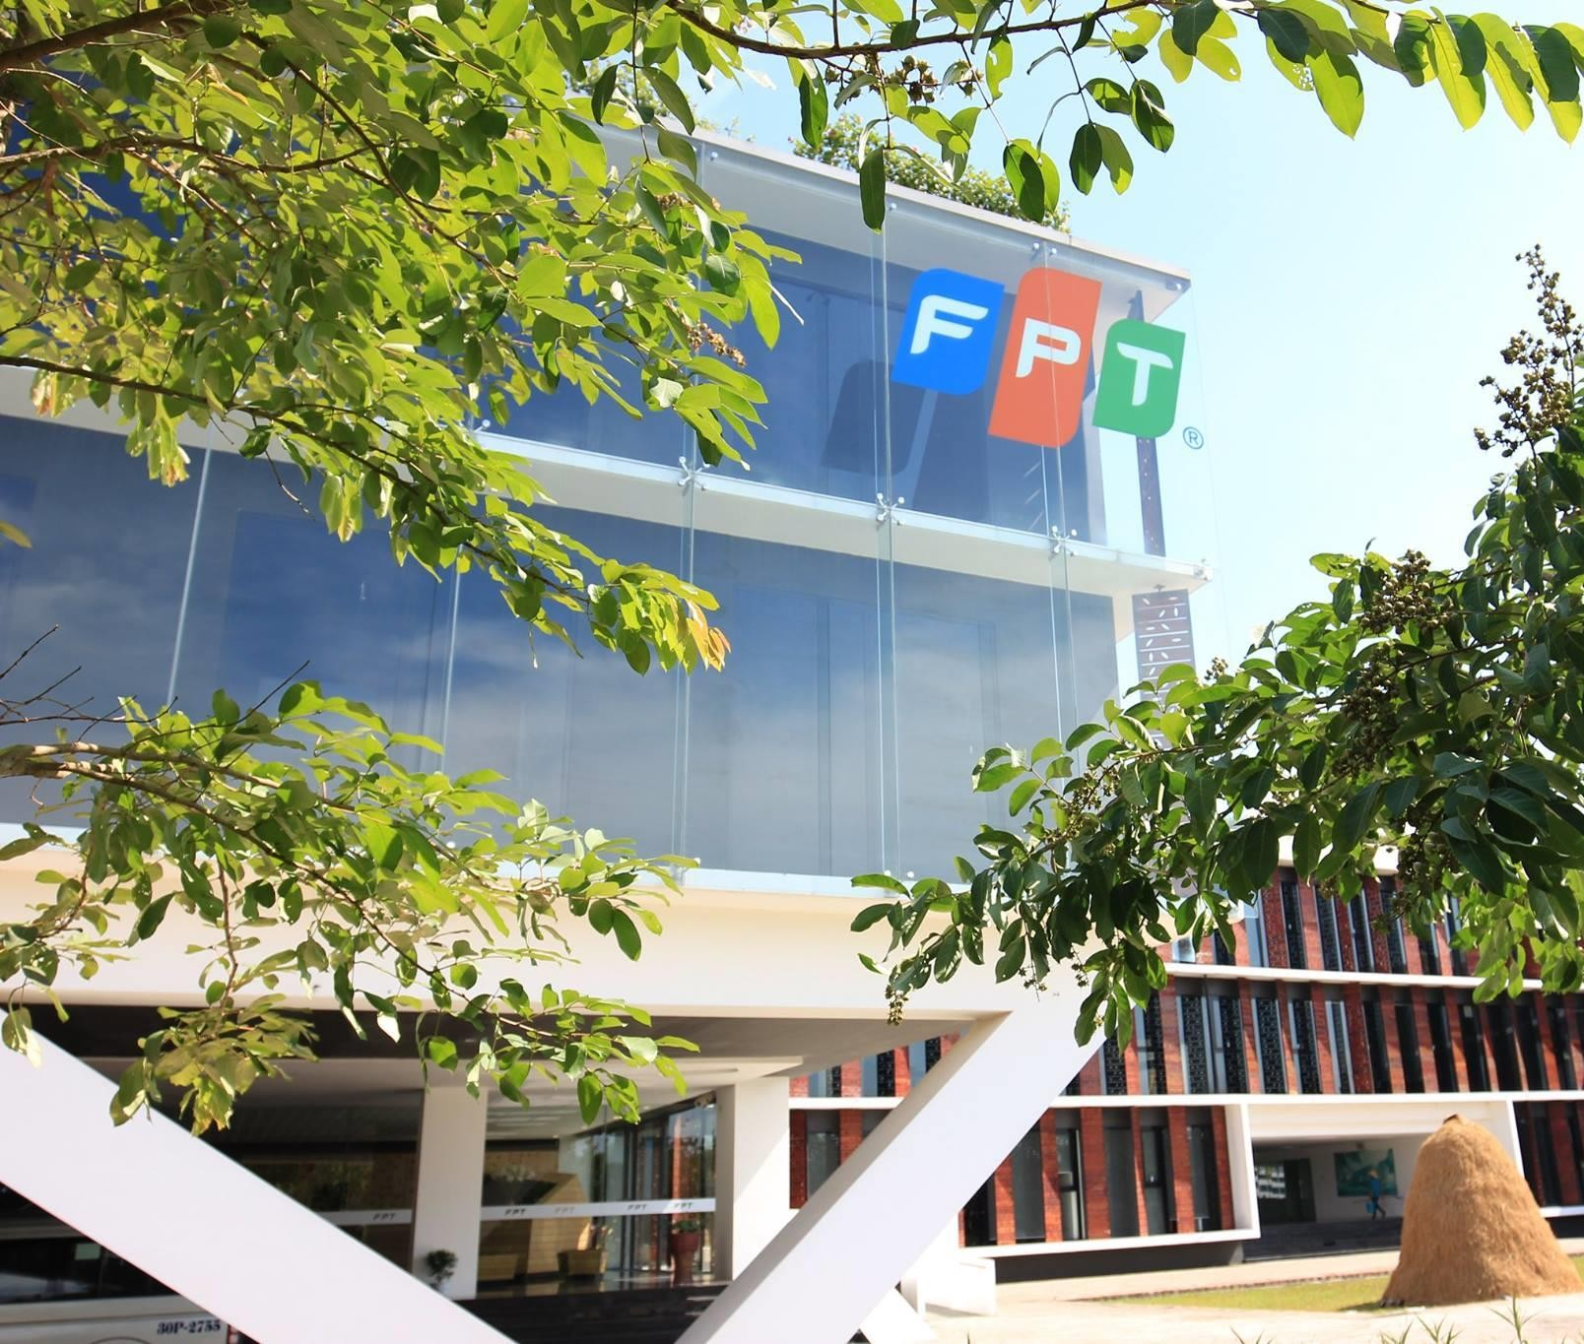




Functions
Confidential ²

Slide 3
#1. How to save data in android app?
Internal Storage (File, Database, Shared Prefereneces)
External Storage (File)

Slide 4
#2. What is room database?
Room database is developed and improved from SQLite. Room database simplifies coding and minimizes database
related operations.
Components: Database, DAO (Data Access Object) and Entity.

Slide 5
#3. Why should use Room Database to change SQLite
In case of SQLite, There is no compile time verification of raw SQLite queries. But in Room there is SQL validation at compile time.
As your schema changes, you need to update the affected SQL queries manually. Room solves this problem.
You need to use lots of boilerplate code to convert between SQL queries and Data objects. But, Room
maps our database objects to Data Object without boilerplate code.
Room is built to work with LiveData for data observation, while SQLite does not.

Slide 6
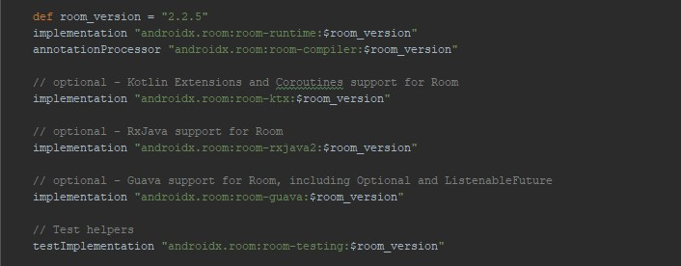
#4. Import Room Database to Project
Grade:

Slide 7
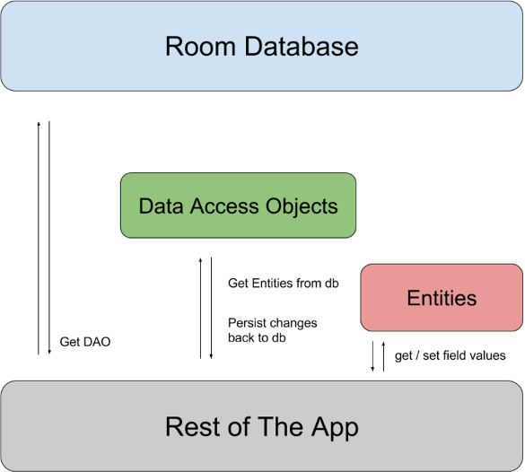
#5. Room Architecture
There are 3 major components in Room:
Database
Entity
DAO (Data Access Object)

Slide 8
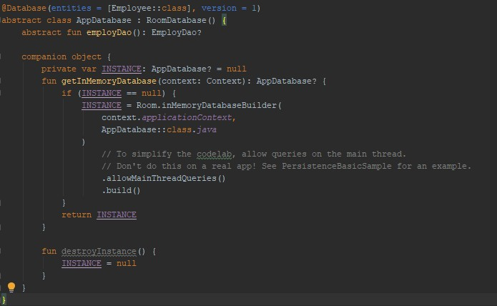
#6. Database – Room Database
Database: Contains the database holder and serves as the main access point for the underlying connection to your app's persisted, relational data. The class that's annotated with @Database should satisfy the following conditions:
Be an abstract class that extends RoomDatabase.
Include the list of entities associated with the database within the annotation.
Contain an abstract method that has 0 arguments and returns the class that is annotated with @Dao. At runtime, you can acquire an instance of Database by calling Room.databaseBuilder() or Room.inMemoryDatabaseBuilder().

Slide 9
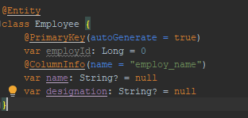
#7. Entity - Room Database
Entity: Represents a table within the database.

Slide 10
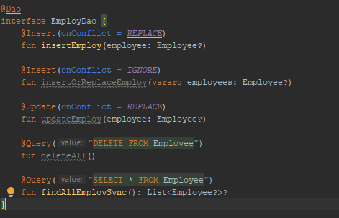
#8. DAO (Data Access Object) - Room Database
DAO: Contains the methods used for accessing the database.

Slide 11

Thank you
5/6/2020
09e-BM/DT/FSOFT - ©FPT SOFTWARE – Fresher Academy - Internal Use
11

